Slide 1
Lecture 21

Slide 2
Question 223.8.1
In the figure, will rays 1 and 2 be in phase?
Yes
No
Can’t tell with the information given
1
2
Air n=1
film n>1
Air n=1
3
4

Slide 3
Question 223.8.2
The thickness of the film is 2 wavelengths. Will rays 1 and 2 be in phase?
Yes
No
Can’t tell with the information given
1
2
n=1
t
n>1
n=1

Slide 6
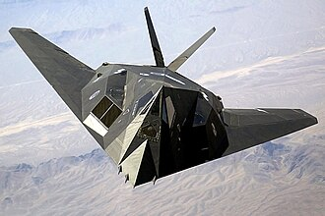
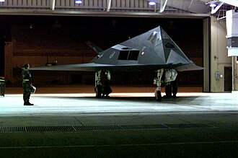

Slide 7
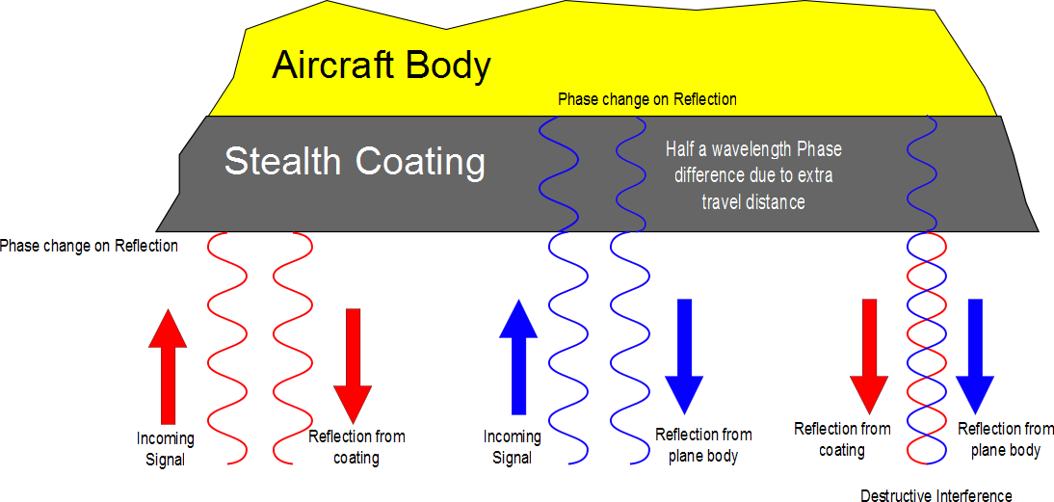

Slide 8
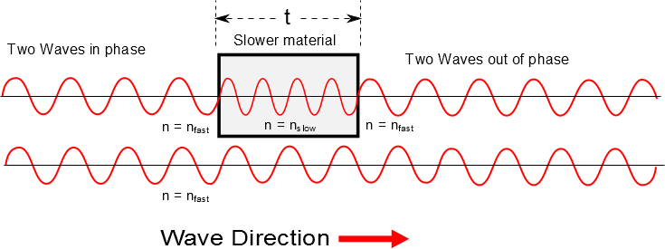

Slide 10
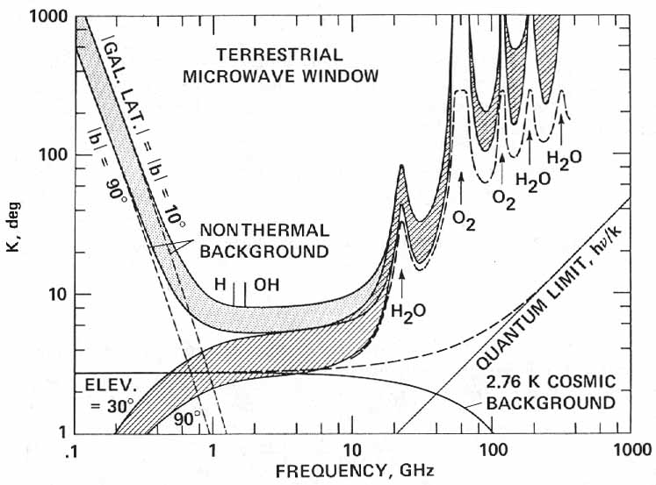

http://history.nasa.gov/CP-2156/p359.htm

Slide 11
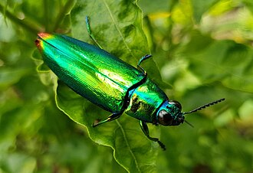

Slide 12
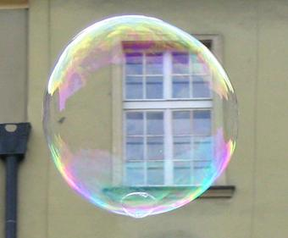
Phase Shift
No Phase Shift
n=1
n>1
n=1

Slide 13
Question 223.8.2.5
The thickness of the film is 2 wavelengths. Will rays 3 and 4 be in phase?
Yes
No
Can’t tell with the information given
1
2
n=1
t
n>1
n=1
3
4

Slide 14
Question 223.8.3
I have two waves coming from speakers in my room. I am sitting 3 wavelengths away from one speaker and 4.5 wavelengths away from the other speaker. I hear..
Twice the normal loudness
4 times the normal loudness
8 times the normal loudness
Practically nothing

Slide 15
Question 223.8.4
I have two waves coming from speakers in my room. I am sitting 3 wavelengths away from one speaker and 6 wavelengths away from the other speaker. I hear..
Twice the normal loudness
4 times the normal loudness
8 times the normal loudness
Practically nothing

Slide 16
A thin film of oil (n=1.25) is located on a smooth wet pavement. When viewed perpendicular to the pavement, the film reflects most strongly red light at 640nm and reflects no blue light at 512nm . How thick is the oil film?

Slide 17
Loud Spot

Slide 18
Loud Spot
Full wavelength farther from the green wave center

Slide 19
Loud Spots

Slide 20
Dead Spot
Half a wavelength farther from the green wave center

Slide 21
Dead Spots

Slide 22
3m
2m
2m

Slide 23
Loud Spot

Slide 24
Loud Spot
Full wavelength farther from the green wave center

Slide 25
Loud Spots

Slide 26
Dead Spot
Half a wavelength farther from the green wave center

Slide 27
Dead Spots

Slide 28
Question 223.8.3
I have two waves coming from speakers in my room. I am sitting 3 wavelengths away from one speaker and 4.5 wavelengths away from the other speaker. I hear..
Twice the normal loudness
4 times the normal loudness
8 times the normal loudness
Practically nothing

Slide 29
Question 223.8.4
I have two waves coming from speakers in my room. I am sitting 3 wavelengths away from one speaker and 6 wavelengths away from the other speaker. I hear..
Twice the normal loudness
4 times the normal loudness
8 times the normal loudness
Practically nothing

Slide 30
3m
2m
2m

Slide 32
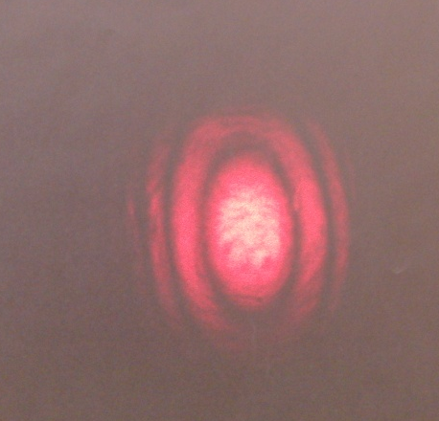
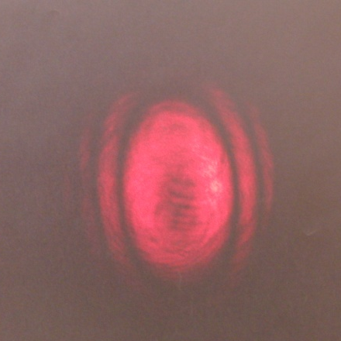
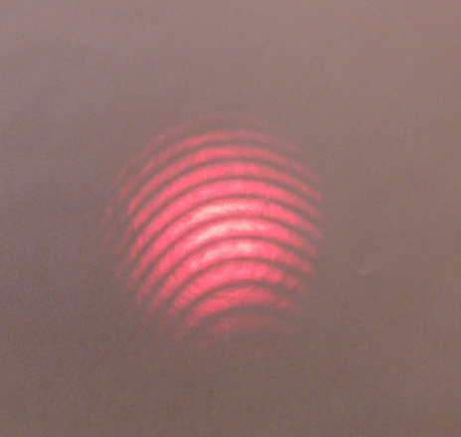
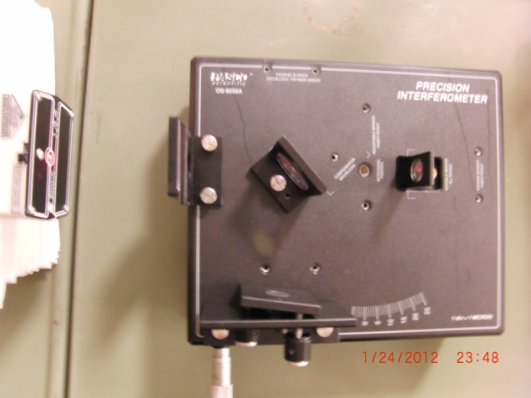
Bright Center
Dark Center
Small Off-Center Fringes
To Screen
Laser
Movable Mirror
Beam Splitter
Fixed Mirror

Slide 33
End

Slide 34
F_{out}
F_{in}
A_{in}
A_{out}

Slide 35
Question 123.5.1
P=0
If the barometer shown here were used on Mars, would h be larger or smaller
Larger
Smaller
h
P_{o}

Slide 36

Question 123.5.2
The pressure at point A in this monometer is ________ the pressure at point B
higher than
lower than
the same as
Pipe with a higher pressure, P_{pipe} that we wish to measure
Δh
A
B
P_{A}
P_{B}

Slide 37
P_{t} = 0
P_{t} = P_{atm}
h
A
B

Slide 38
Pressure Measurement: Barometer
P_{t} = 0
In many pressure measurements, the idea is to make the pressure due to a column of fluid equal to the pressure to be measured
For the barometer,
We solve for the height of the liquid (usually Hg)
Would a water be practical to use for a barometer?
P_{t} = P_{atm}
h
A
B

Slide 39
Pressure Measurement: Barometer
P_{t} = 0
In many pressure measurements, the idea is to make the pressure due to a column of fluid equal to the pressure to be measured
For the barometer,
We solve for the height of the liquid.
For water this would be
P_{t} = P_{atm}
h
A
B

Slide 40
Pipe with a higher pressure, P_{pipe} that we wish to measure
Δh
A
B
P_{A}
P_{B}

Slide 42
Question 123.5.3
Take a beach ball sized parcel of water. What happens if we replace the parcel with the beach ball?
The ball will rise because it is less dense than the water
The ball will rise because the buoyant force will be larger for the beach ball
The ball will rise because it’s surface area will be different than the parcel of water
B
F_{g}

Slide 43
Question 123.5.3.5
We say that there is a buoyant force acting on the beach ball. What is the buoyant force?
It is the net force on the beach ball
It is the net force due to the water pressure acting on the beach ball
It is a force that makes things float at the surface
50

Slide 44
Buoyant Forces
Remember from
a stationary parcel of water there is a force that balances the weight of the parcel
Forces that act in the x-direction (sideways) balance each other
-P_{o}Aĵ
P_{m}A x
-P_{m}A x
j
PAĵ
i
Mg

Slide 45
Buoyant Forces
Now take a beach ball sized parcel of water
There is a force due to gravity and a force due to the pressure
What happens if we replace the parcel with the beach ball?
B
W

Slide 46
Archimedes’ Principle
The magnitude of the buoyant force always equals the weight of the fluid displaced by the object
For a cube
F_{t}=-P_{o}Aĵ
We know the force for a cube shaped parcel of water
B
h
h
Where M is the mass of the parcel of water
Mg
F_{b}=PAĵ
W
By replacing the cube of water with a cube of another material, we have not changed the forces acting on the cube

Slide 47
Case1: Totally Submerged Object
The magnitude of the buoyant force is
Think Archimedes: The weight of the fluid displaced by the object. So we have the volume of the object as part of our equation
If the object has mass
B
V_{object}
h
The net force is
F_{g}
The motion of an object submerged in a fluid is determined only by the densities of the object and the fluid

Slide 48
Buoyant Forces
Now take a beach ball sized parcel of water
There is a force due to gravity and a force due to the pressure
What happens if we replace the parcel with the beach ball?
B
W

Slide 49
Case 2: Partially Submerged Object
Assume and static equilibrium.
We define V_{fluid} as the volume of the fluid displaced by the object.
Then
B
V_{displaced}
W
The fraction of the volume of a floating object that is below the fluid surface is equal to the ratio of the density of the object to that of the fluid.

Slide 50
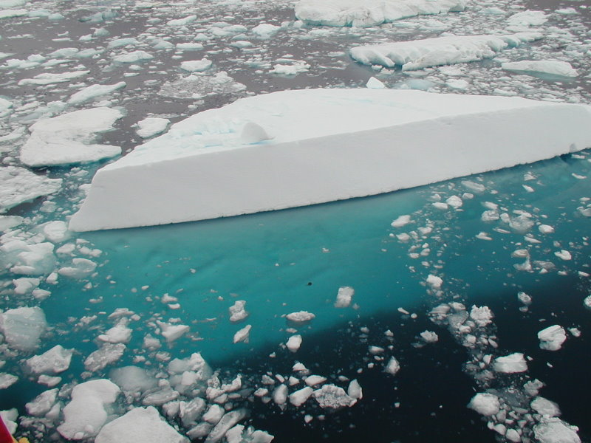
Iceberg with the submerged portion visible. From Geo Swan used under the licensed under the Creative Commons Attribution 2.0 Generic license.

Slide 51
Question 123.5.4
Two cups are filled to the same level with water. One of the two cups has ice cubes floating in it. When the ice cubes melt, in which cup is the level of the water higher?
h
A
B

Slide 52
Question 123.5.5
When a ball is floating on the surface of a pool, how does the force needed to push it under change with depth?
A
F
B
F
B
F_{g}
h
h
h
F
C
h

Slide 53
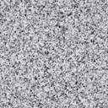
Question 123.5.6
I have somehow suspended a block of concrete in a fluid. I replace the concrete with a block of Styrofoam with equal volume. The buoyant force on the Styrofoam is
Larger than
smaller than
the same as
The buoyant force on the concrete.

Slide 54
